Slide 1
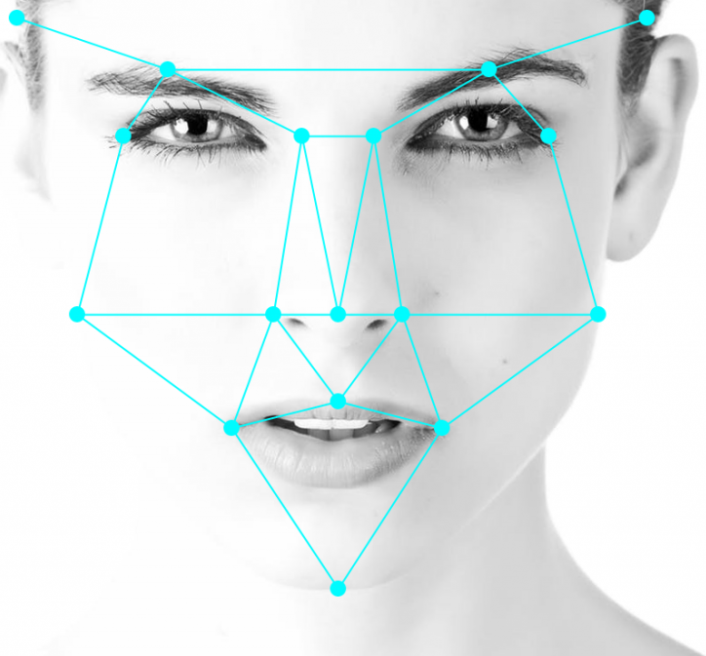
Facial Recognition
Notes:
In recent years, facial recognition has seen widespread adoption due to advances in artificial intelligence and deep learning technology that made it possible for systems to process enormous amount data quicker and more efficiently.

Slide 2

NODES
Notes:
Modern facial recognition software is a form of biometrics that map facial features called landmarks or nodal points from a photograph or video. These landmarks could include the distance between the eyes, the width of the nose, depth of eye sockets, distance from forehead to chin, and 100 more different measurements which is converted into an individual’s facial signature using mathematical formulas. It then compares these features with a database of known faces to find a match which all occurs in a matter of seconds.

Slide 3

( x , y , z ) “Region of Interest (ROI)”
Notes:
One of the very first step of facial recognition is the process of image segmentation to locate the region of interest.. Which in this case is locating the coordinates of the face within a 3D space. This process is mimics that of a person when locating objects within our peripheral vision and making mental notes of their location.

Slide 4
Facial Detection with Deep Learning
Fast
Modified Histogram of Oriented Gradients
Quality
Modified Region-Based Convolutional Neural Network
Notes:
This task can easily be accomplished using deep learning. Which in this this project, two methods were used to get fast results using a modified method of HOG or quality results using a RCNN.

Slide 5
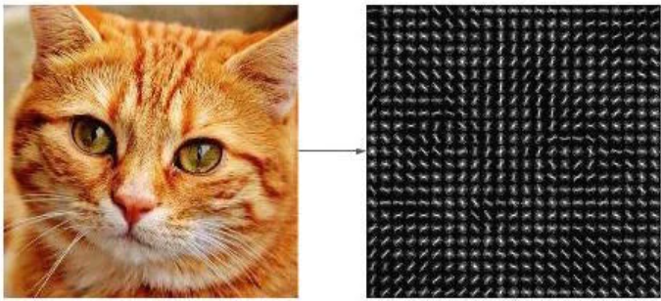
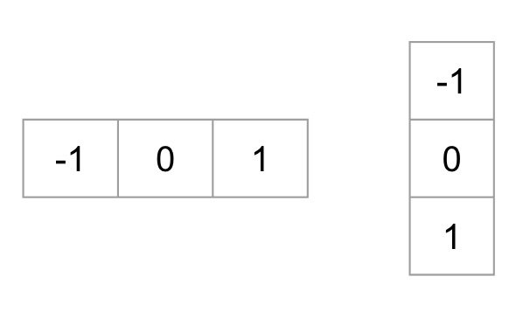
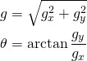
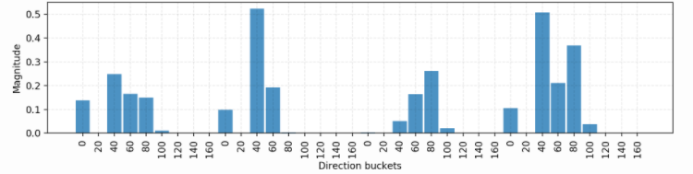
Histogram of Oriented Gradients
Kernels
Magnitude &
Direction
Calculation
Input Image
Output
Sample Histogram of Oriented Gradients
Notes:
(HOG) is a feature descriptor used to provide visual features of the contents in images, videos, algorithms, and application which produces descriptions like facial features that include color, shapes, textures, size, and fill.
Its main goal is to convert an image into a feature vector that can be used in image recognition and object detection.
This HOG descriptor calculates the distribution or histograms of oriented gradients by using a horizontal (x) and vertical (y) gradients that are created from filters using a Sobel operator with a kernel size of 1.
Once the gradients are calculated in an image, the gradient magnitude and directions are calculated using the following mathematical formula.
The next step is to then apply these whole mathematical method to the entire image by dividing the original image into small 8x8 patches with then returns a 3Dimensional vector feature based on the magnitude and direction values. These are called a 128 embedded bin histogram. Once we’ve normalized these values, these feature vectors are concatenated into a giant vector containing the dimensional vector of the image.

Slide 6
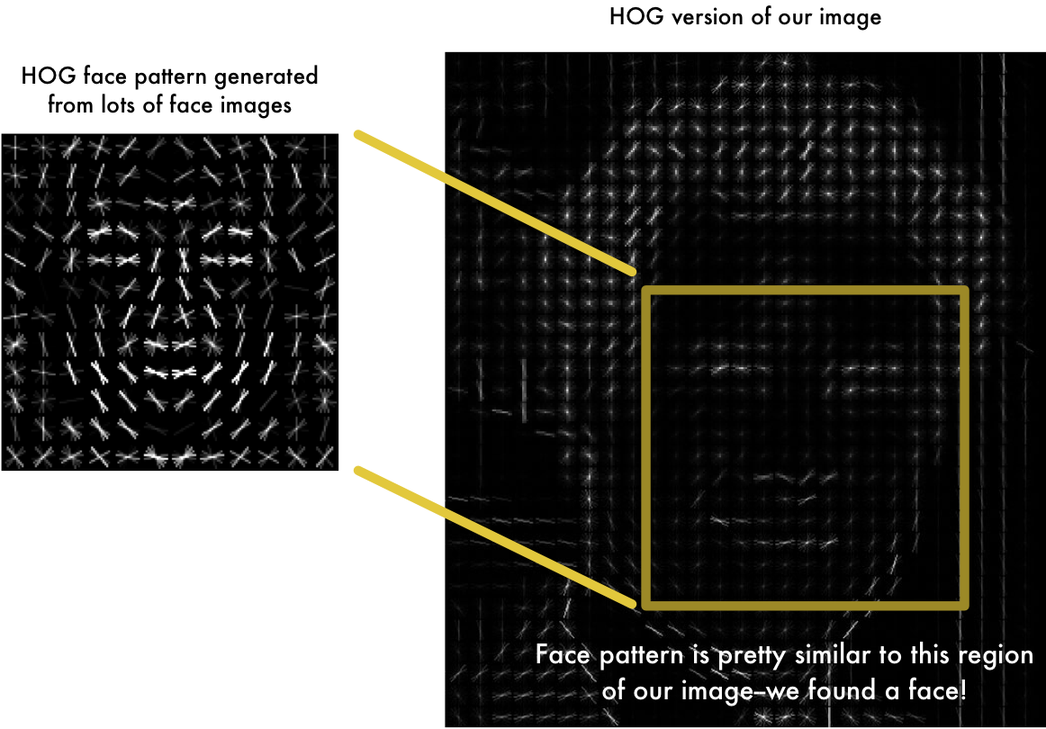
Histogram of Oriented Gradients
Notes:
By converting facial patterns to a real-value vector to represent the basic structure of human face, it is then used to extract the coordinates of similar vector values within an new image.
One of the problem with this method is that the face must be as centered as possible for the algorithm to be utilized. To account for this, a face landmark estimation algorithm is used to warp the vector values as centered as possible even if the face is looking in different directions.

Slide 7
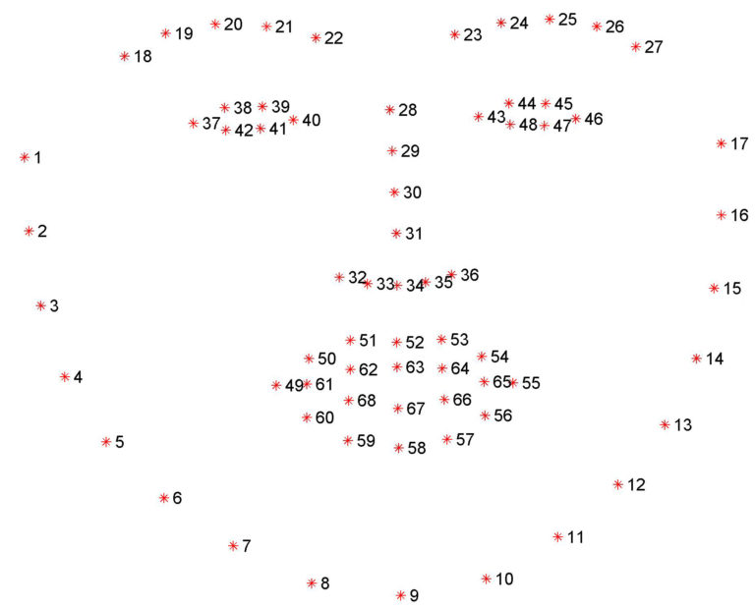
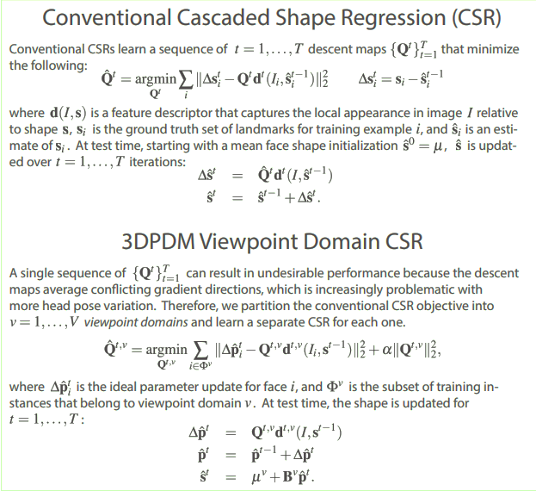
Facial Landmark Estimation
Landmarks
Notes:
The basic idea is to used a series of cascade shape regressions to transfer specific points of the existing face into “landmarks”.

Slide 8
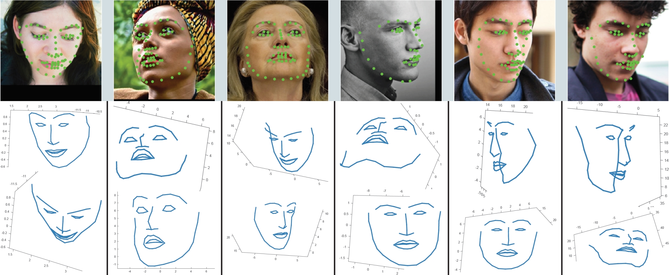
Facial Landmark Estimation
Notes:
These landmarks capture the pattern calculated in the whole face including all the small features and simply rotate, scale, and sheer the image so that these features are centered as best as possible by using affine transformations without introducing any distortion

Slide 9

RCNN Classification Pipeline
Architecture
1
2
3
4
Selective Search
Sorting Algorithm
Model Prediction
Non-Max Suppression
Image
Export Data
ROI
Sorted Images
Predictions
Cleaned Up Images
Notes:
Although that method of facial detection is accurate 98% of the time , it can easily misclassify and sometimes not locate faces due to unaccounted circumstances.
And so, to vastly improve the accuracy, a modified brute force method is used in conjunction with the faster method, called a Region-based Convolutional Neural Network (RCNN).

Slide 10
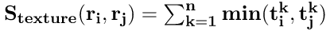
RCNN Classification Pipeline
Felzenszwalb’s superpixel generation method
Generates region proposal candidates based on:
Color Similarity
Texture Similarity
Size Similarity
Fill Similarity
Notes:
The backbone of this deep learning pipeline involves Felzenszwalb’s superpixel generation method, which creates a selective search algorithm that filters an image by utilizing a series of equation that divides an image based on color similarity, texture similarity, size similarity, and fill similarity. Regions of proposal candidates can then be created by using a merging equation to create single components.

Slide 11
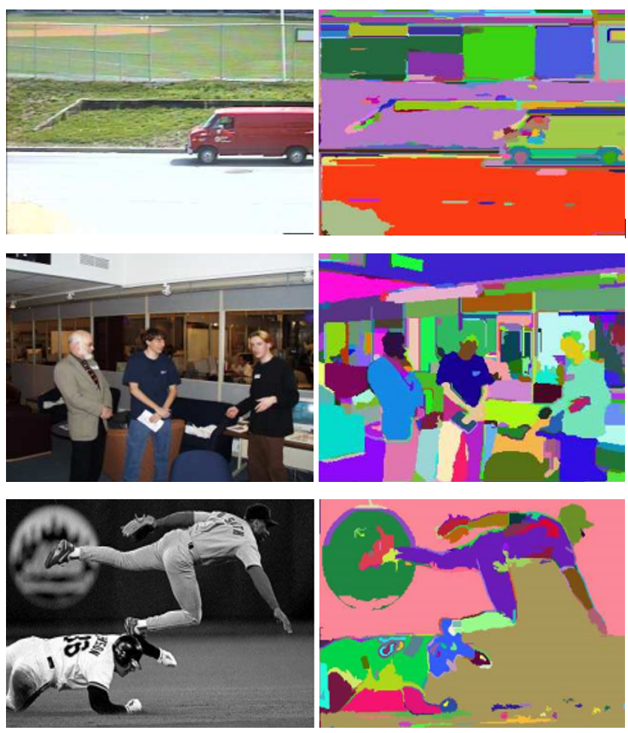
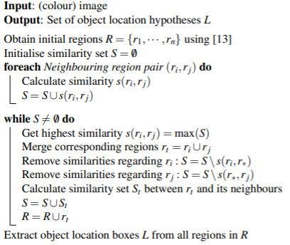
RCNN Classification Pipeline
(Pseudocode)
Notes:
Using these series of equations, we only output regions of interest with actual objects within itself and not thousands of redundant and empty images.

Slide 12
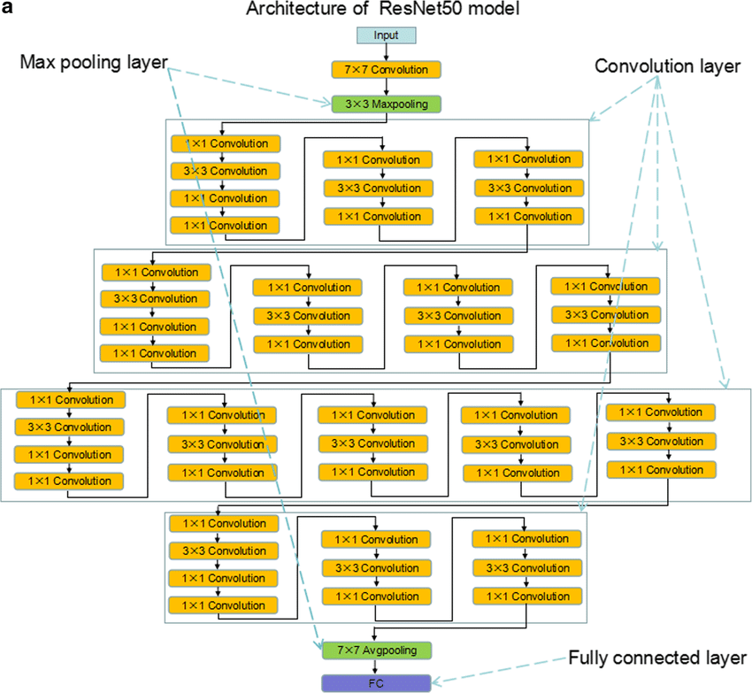
RCNN Classification Pipeline
ResNet50 Architecture
Notes:
The RCNN is then trained in tandem with the data collected in the from the HOG with a model consisting of convolutions, pooling, comparisons, and 50 dense layers which equates into millions of parameters for the deep learning network to train with.
This model is easily retrainable and can account of abnormalities and still detect facial features if necessary.

Slide 13
Facial Recognition with Deep Learning
Fast
Modified Histogram of Oriented Gradients
Quality
Modified Region-Based Convolutional Neural Network
Notes:
Now that we have a deep metric learning to detect faces, we can now move on to the facial recognition to get peoples identities

Slide 14
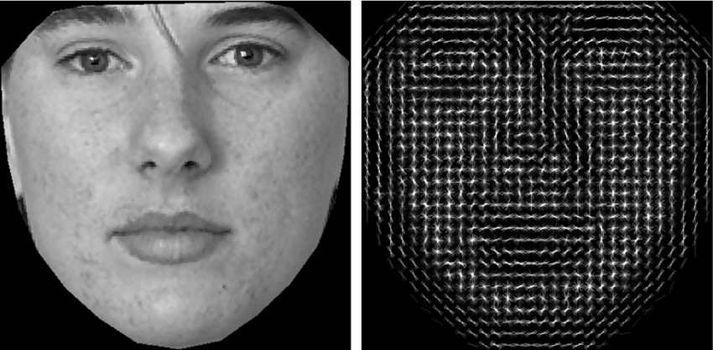
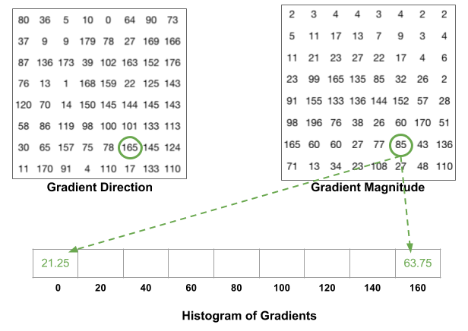
Histogram of Oriented Gradients
Notes:
Once a face is detected, it is then transformed into a 128 embedded blueprint. The more data that is collected in one’s facial identity, the more keys can be used to this identify a person.
Once a database of the person’s blueprints have been created, these are then saved as the pretrained weight used for classification. When a facial detection recognized a face in a new image, it will then compare it with the database landmarks to identify the face.

Slide 15
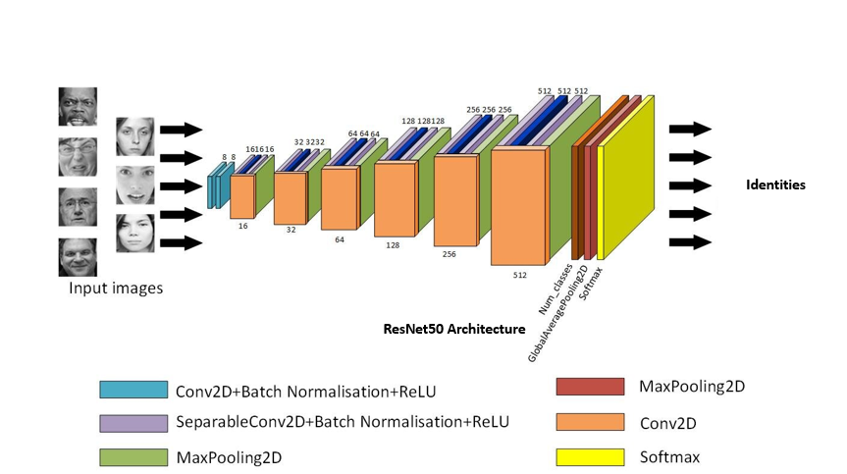
RCNN Classification Pipeline
Notes:
The RCNN is simply defined and trained with numerous amount of dataset, while being trainable with new dataset.

Slide 16
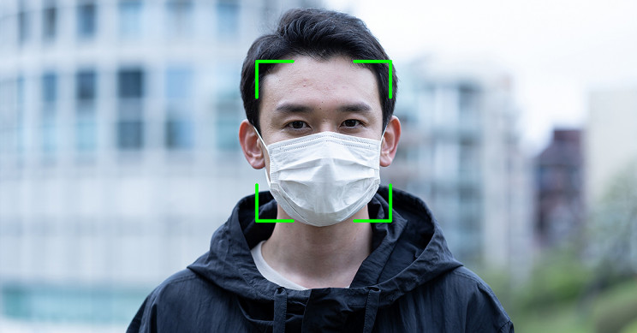
Notes:
One of the biggest problems in this project in addition is that this algorithm must now be written to now detect and classify individuals with facial coverings

Slide 17


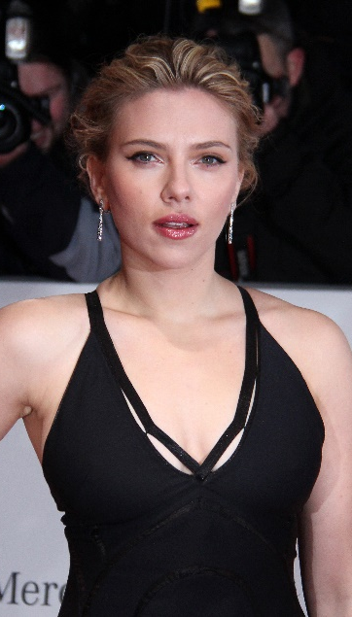
Hair
Eyes
Ears
Chin
Facial Feature
Distance
Notes:
To achieve a solution, we can investigate how the human brain has already solved this problem.
Given the two images shown, our human brain can tell that these two images are of the same person. But how?
The answer is simply that the facial features are still similar outside of the facial covering, and out brain can make a good estimation of the identity of the person.

Slide 18
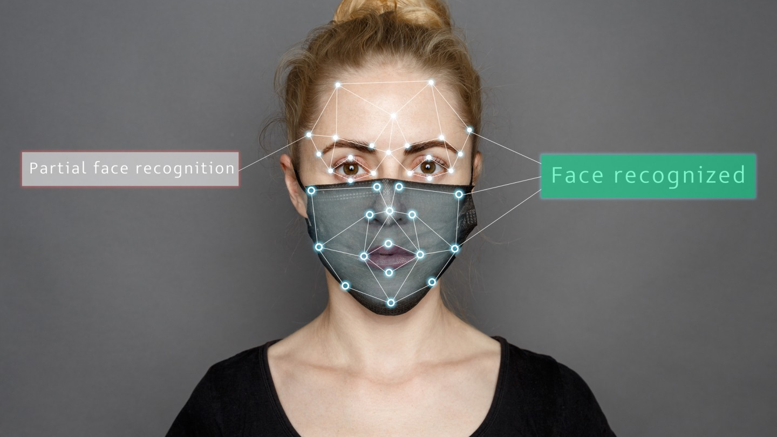
Notes:
To account for the facial coverings, the facial landmarks estimation can be rewritten to account for the missing features of the face and still make a good estimation based on the unblocked facial features such as the eyes, chin, ears, and forehead.

Slide 19
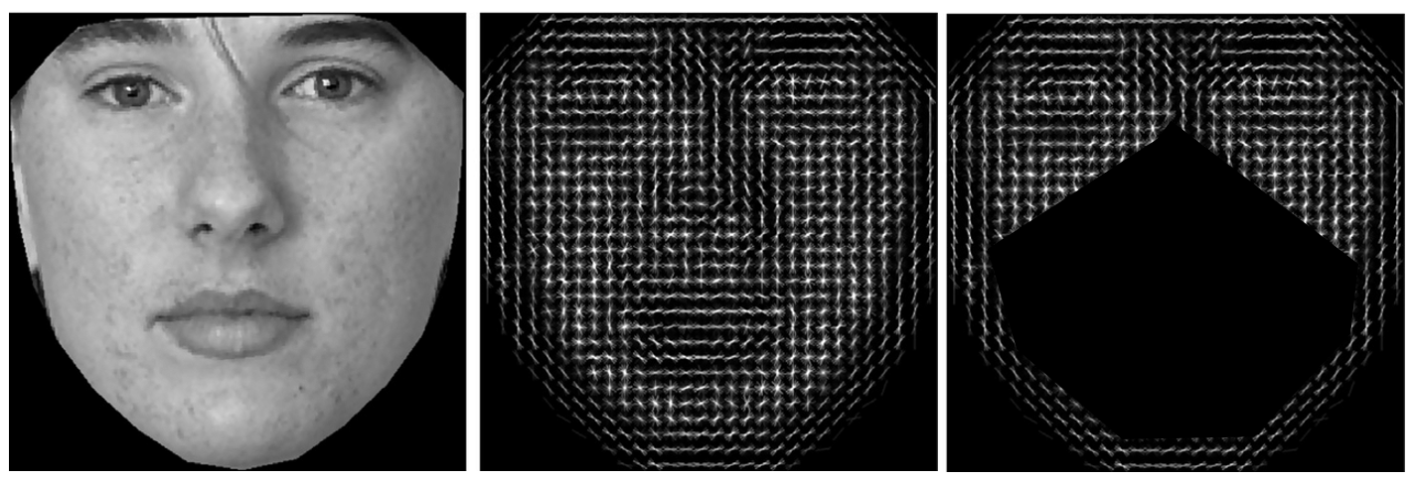
Histogram of Oriented Gradients
Gradients
Notes:
Since majority of the data is now blocked from the facial covering, the algorithm can be modified to account for the missing spaced by either upscaling the image or making the kernel filter smaller. With this method, we can create the same amount of vector values to classify the individual.

Slide 20
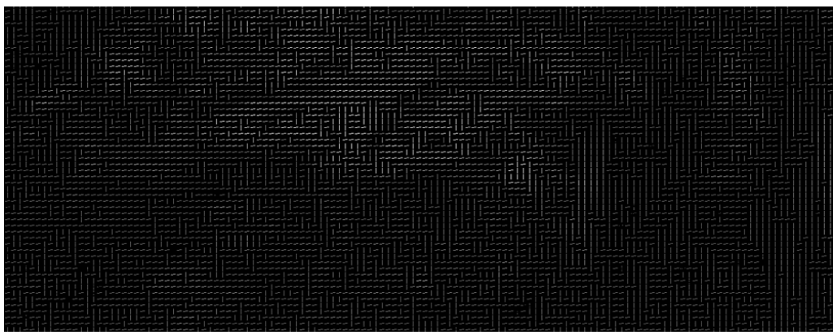
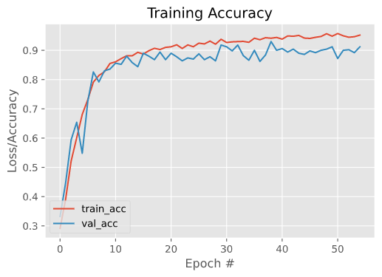
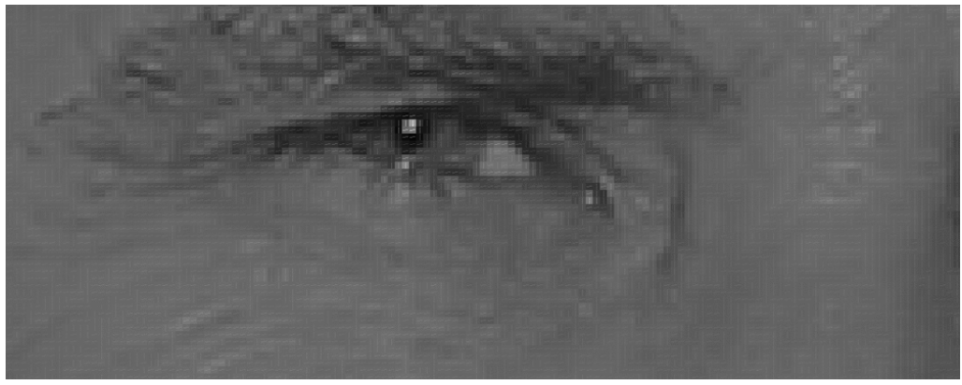
Notes:
By focusing on the small feature of the face and creating the classification pipeline from it, as it turns out that deep learning models are really good at classifying who a person might be just on the small facial features of the face and achieving up to a 98% accuracy

Slide 21
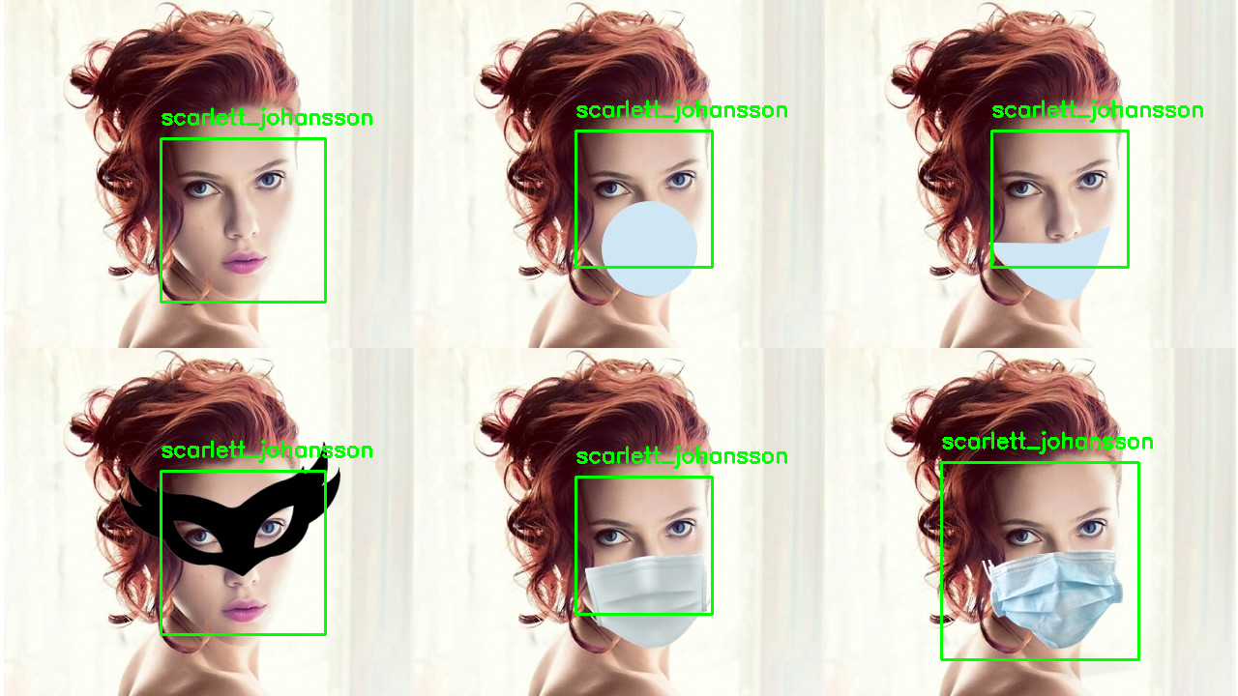
Notes:
Deep learning results

Slide 22
